Slide 1
Supply and Demand

Slide 2
Great Slide Share
http://www.slideshare.net/fullscreen/Qindeel/the-market-forces-of-supply-and-demand/4

Slide 3
Law of Supply
Supply: The amount of goods producers are willing to make and sell.
Law of supply – Price and quantity supplied move in the same direction.
As prices rise, the quantity supplied generally rises
As prices fall, the quantity supplied by sellers falls.

Slide 4
Law of Demand
Demand: The consumers willingness and ability to buy products.
Law of demand: Price and demand move in OPPOSITE directions.
As price increases, demand falls.
As price decreases, demand rises.

Slide 5
Surplus
Surplus: When supply exceeds demand you have excess inventory sitting around known as surplus.
Possible Causes (others are discussed later)
Price is too high, customer perceptions are negative, substitute products exist

Slide 6
SHortage
Shortages: Demand exceeds supply.
Examples
Oil shortages drive gas prices up.
Bad weather situations (storms, drought, etc.) drive up the prices of food items.

Slide 7
Equilibrium
Equilibrium: When the amount of product being supplied is equal to the amount being demanded.
No price hikes or discounts are needed to sell the product.
Customers receive a fair price and business receive a steady flow of business. Everyone wins!

Slide 8
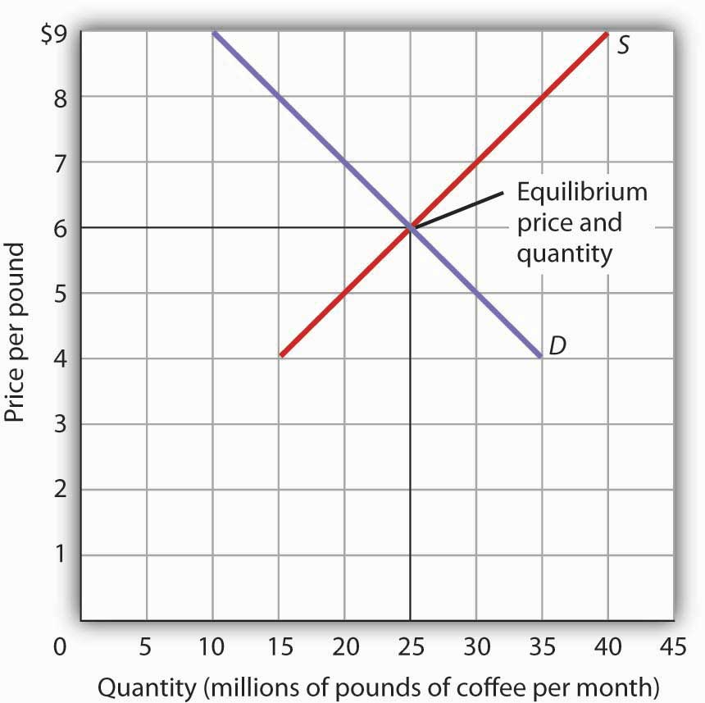
Equilibrium Example

Slide 9
Factors affecting Supply and Demand
Factors affecting supply include the possibility of profit, amount of competition and the capability of developing and marketing the products and services.
Factors affecting demand include Strength of want or need, availability of supply, availability of alternative products that consumers believe will satisfy their need/want.

