Slide 1
How To Describe a Print ad using aida

Slide 2
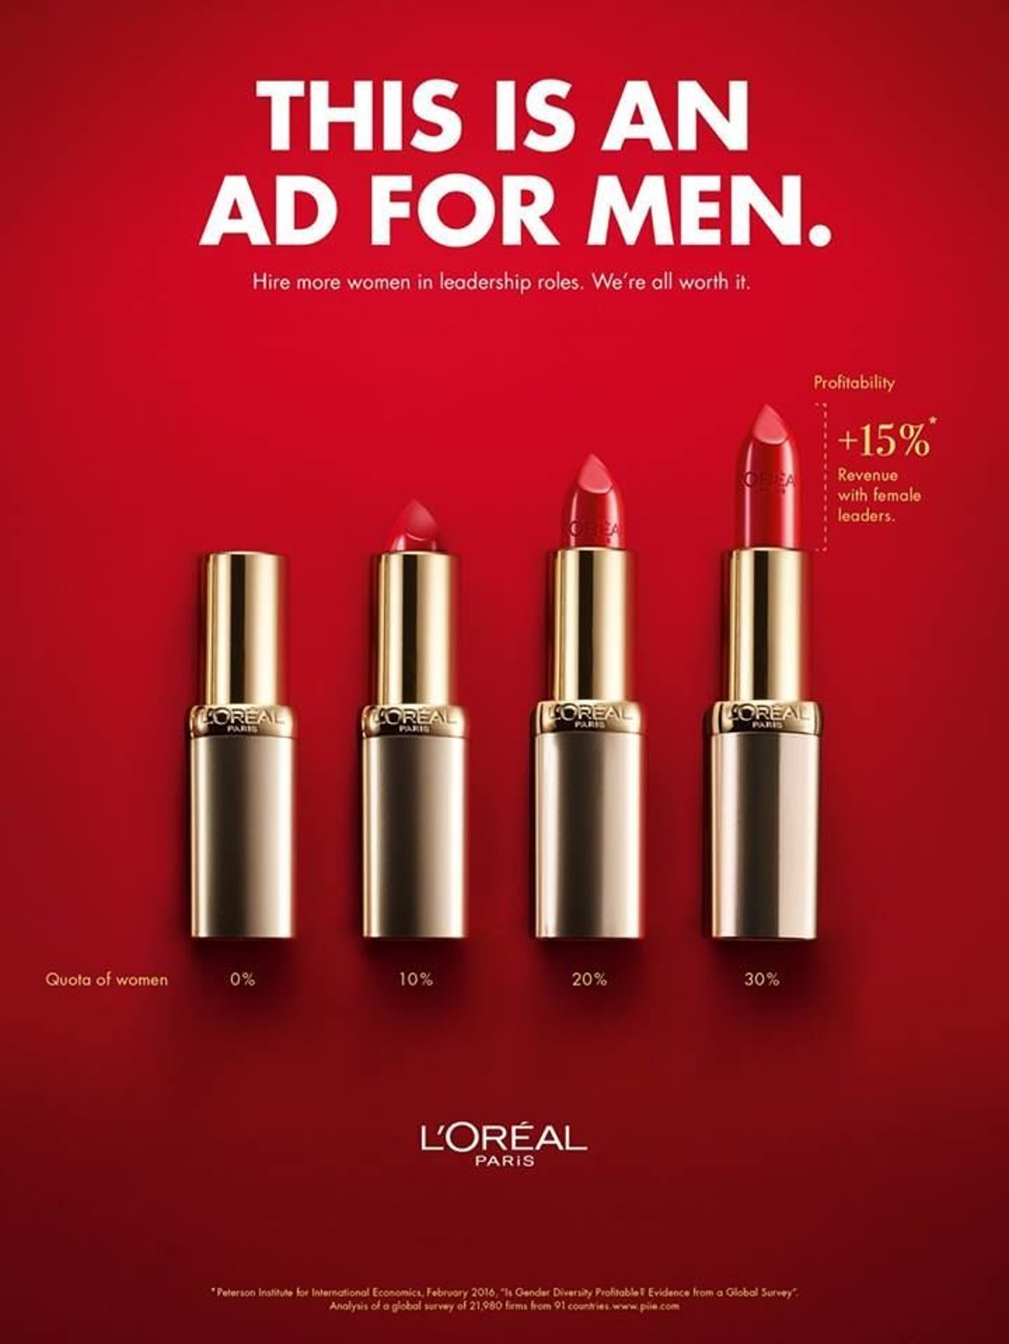
Attention Attention: What gets the viewers attention in the first 2 seconds?

Slide 3
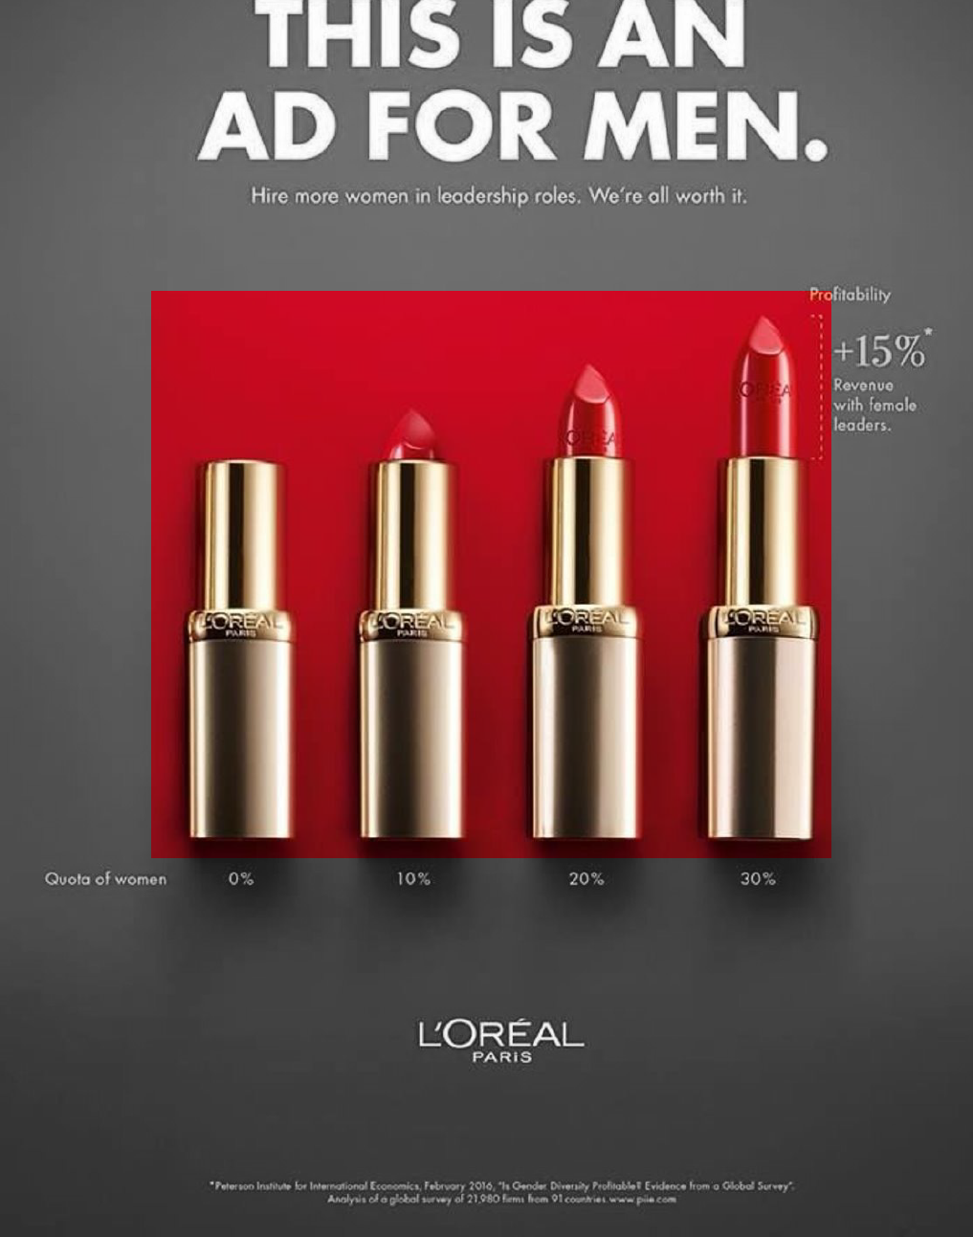
ATTENTION
The target market is business executives.
Bar charts are very familiar to them.
Their attention is peaked by the bar chart being made of lipstick.

Slide 4
Attention interest: what keeps the viewer’s interest so they receive the message and don’t turn the page?

Slide 5
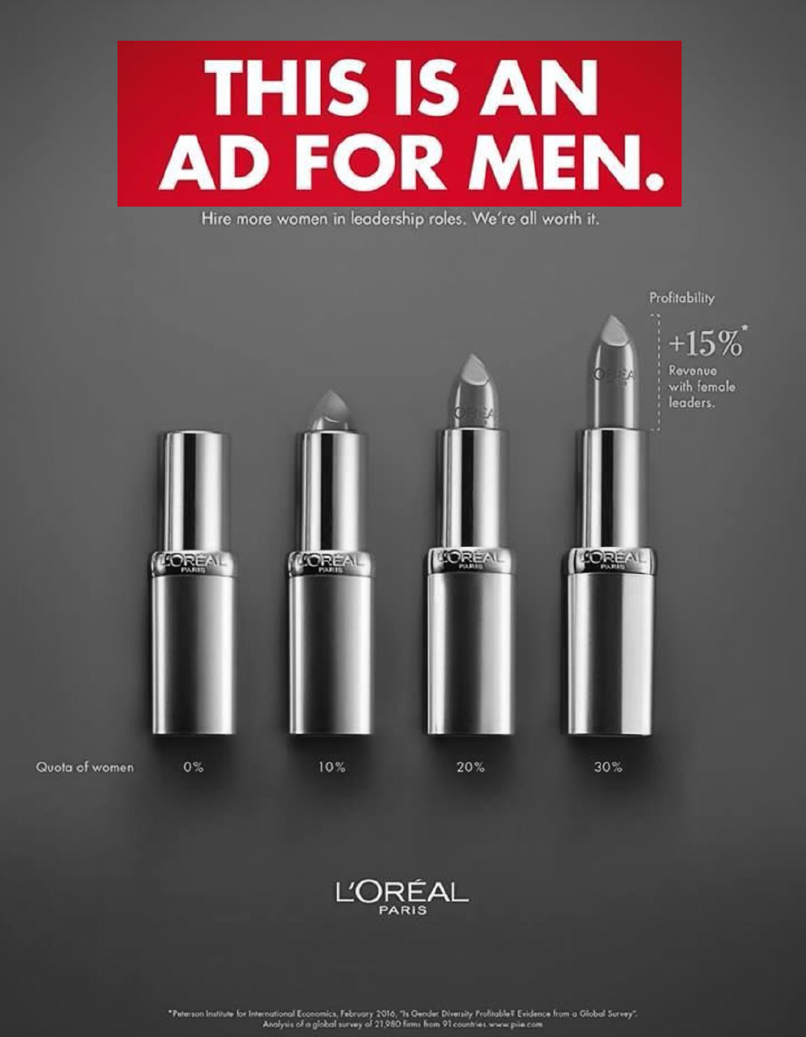
INTEREST
An unexpected headline creates interest and keeps the view from turning the page.

Slide 6
Attention desire/Emotion: What does loreal want you to desire? What emotion do they want you to feel?

Slide 7
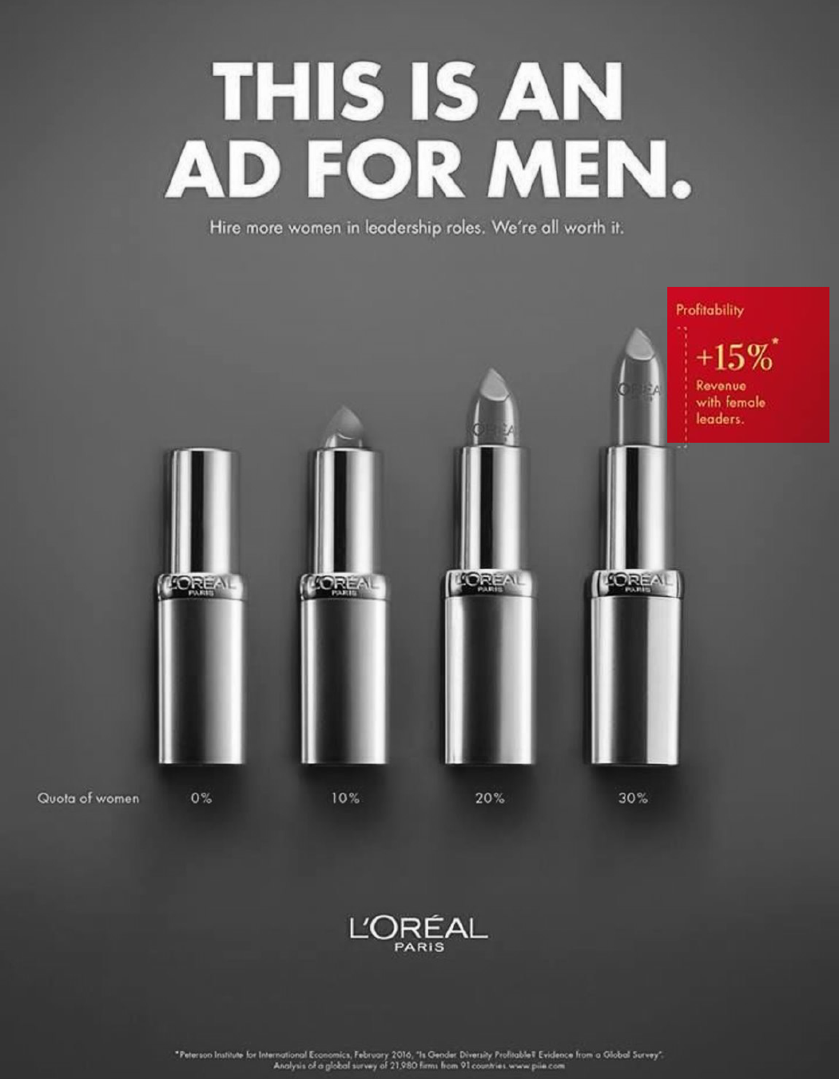
DESIRE/EMOTION
Attention
Possible Emotions
Curiosity Shock Intrigue Pride Excitement Empowerment

Slide 8
Attention Action: what action does the company want the viewer to take after seeing the ad?

Slide 9
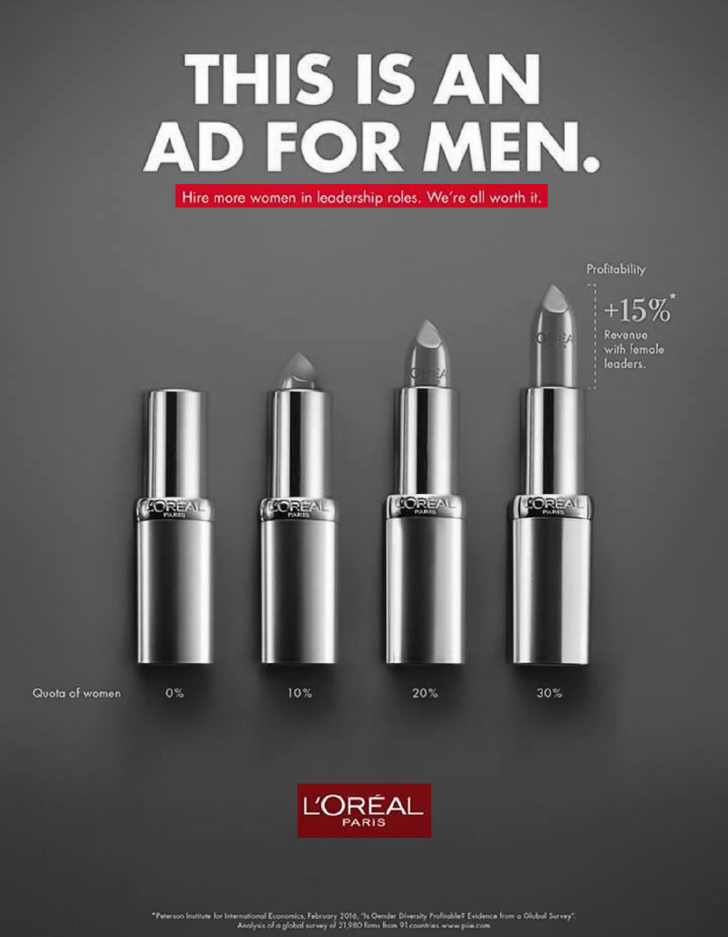
DESIRE/EMOTION
Hire more women
Support L’O’REAL Products because they support women’s rights

Slide 10
Recalling prior knowledge
Can you explain this ad by using the AIDA principle and any other design principle you have learned in this unit?

Slide 12
Ticket out the door
Explain this ad by using the AIDA principle and any other design principle you have learned in this unit? Type your thoughts on a Word document and submit it to Canvas.

