Slide 1
Product Pricing

Slide 2
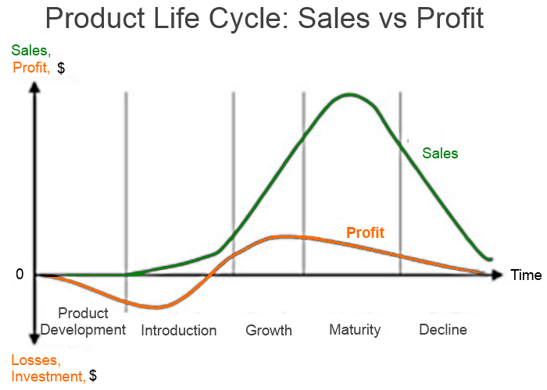

Slide 3
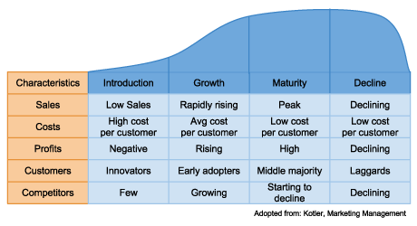

Slide 4
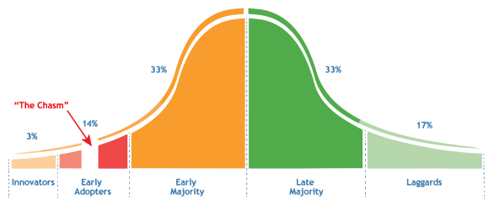
Technology Life Cycle

Slide 5
Explanation of “the chasm”
These categories seem to show a neat progression. However, in the technology adoption lifecycle, there’s often a large gap between your early adopters and the early majority. This gap is known as the ‘chasm’, and it’s stopped many a software product in its tracks.
The reason it’s so difficult to cross the chasm is that there’s a huge difference between the needs of your early adopters, and the needs of the early majority. It all comes down to embracing change.
Early adopters are game for trying something new and unproven; they’re willing to test new tech in order to set trends. The early and late majorities that will adopt your software, meanwhile, are altogether more risk-averse. They need proof that the product will help them.
So, if your product is still more ‘cool’ and ‘cutting-edge’ than it is tangibly successful and secure, it won’t make it past the early adopters.

Slide 6
Watch a short video on The Product Life Cycle
https://www.youtube.com/watch?v=wYeXCeBZhjE

Slide 7
Pricing Strategies
Skimming Pricing – Price is set high to capitalize on the high demand during its introductory period, then later lowered as competition catches up and growth starts to flatten.
What product uses a skimming strategy?

Slide 8
Pricing Strategies
Penetration Pricing – Initial price is set low in order to “penetrate” a tough market that is saturated by a lot of competitors with similar products. It can also be used to simply encourage as many people as possible to buy a product.
What product uses a penetration strategy?

Slide 9
Pricing Strategies
Prestige Pricing – Prices are set higher than average to suggest status and an upscale image to the consumer.
What product uses a prestige strategy?

Slide 10
Pricing Strategies
EDLP – Consistently low prices are set with no intention of ever offering a discount. This pricing strategy is employed when low unit profit margins are expected to be offset by a high sales demand.
What store uses an EDLP strategy?

Slide 11
Pricing Strategies
Cost -Plus Pricing – All costs and expenses are determined and then the desired profit is added to arrive at a price. This is used when a bottom line profit margin must be met and the product is predicted to be able to remain in high demand without offering a discount.
What store uses a cost-plus strategy?

Slide 12
Pricing Strategies
Geographical Pricing - Price adjustments required because of the location of he customer and the associated delivery costs.
This is why things are more expensive in Alaska and Hawaii

Slide 13
Pricing Strategies

Slide 14
Discount Pricing
Seasonal Discounts – Discounts are offered to buyers who are willing to buy in advance of the customary buying season. This prevents cash flow problems by keeping a steady stream of revenue coming into a company all year.
Cash Discounts – Buyers who are willing to pay in cash receive a cheaper price

Slide 15
Which Strategy to choose?
Every circumstance is different and the strategy usually fluctuates throughout the life cycle.
Question: How can you get a product back into the growth stage once it reaches the maturity stage?

Slide 16
Setting a Price
The six steps for determining price are:
Determine pricing objectives
Study (and list) costs
Estimate demand
Study (and list)competition
Decide on a pricing strategy (provide justification)
Set price

Slide 17
Increasing Your Prices
Be able to justify the price increase to your customers or they will seek other alternatives!
You’re improving the specification or quality of the products.
You’re introducing new, higher priced products with more benefits or functionality that make older products less attractive or obsolete.

