Slide 1
Product Pricing

Slide 2
Oh No, I signed up to Role Play…Now What?

Slide 3
What do You Need to Know For A Role Play?
Marketing Knowledge | Professionalism & Attitude
Industry Knowledge | Trendy Info

Slide 4
6 Steps to a successful experience!
Study the sample tests
Look up general marketing terms
Look up trends in your industry
Practice using your soft skills
Practice your ESOMIE pitch over and over!
Know the basics of the 4 P’s(discussed in this presentation)

Slide 5
The least you should know
Soft Skills
What ESOMIE is (Practice your pitch!)
Product benefits and life cycle
Pricing Strategies to use
Promotion Types (advantages of each)
Placement - Intermediaries

Slide 6
The video and slide show that we viewed in class are linked below for reference.
https://www.youtube.com/watch?v=wYeXCeBZhjE
http://www.slideshare.net/gadekar1986/product-life-cycle-12816142?related=1

Slide 10
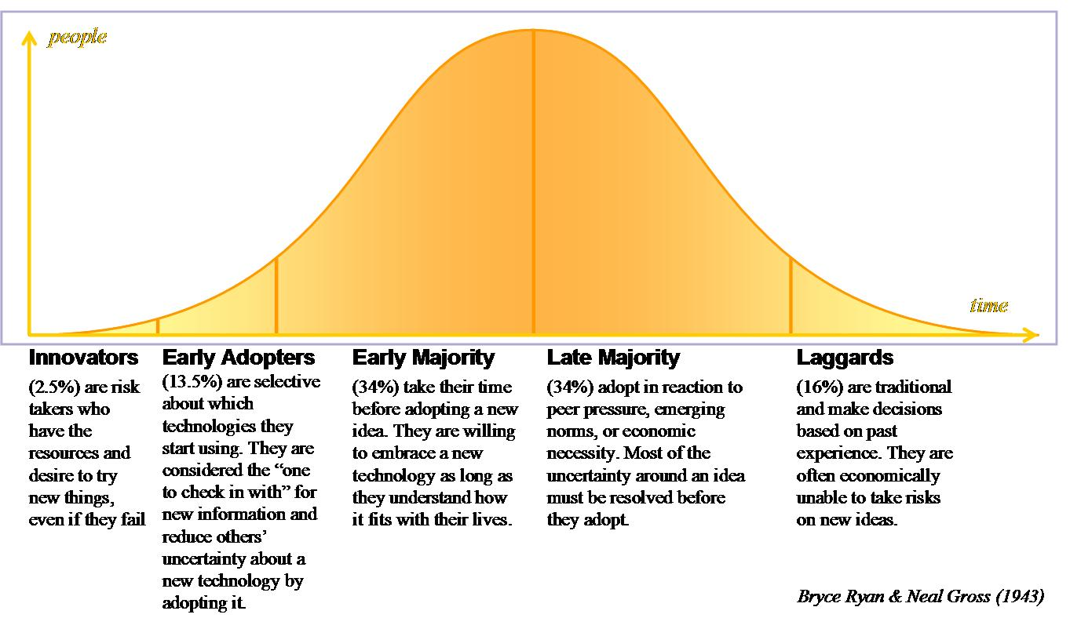

Slide 11
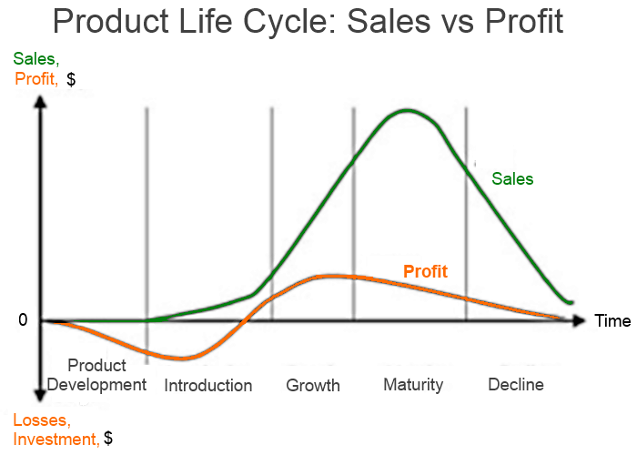
After viewing this information, can you explain the stages of the PLC and provide examples if given the diagram below? Give it a shot.

Slide 12
In attempting to explain the stages, you should have said something similar to the items on the next slide.
View the slide to see if you are on track.

Slide 13
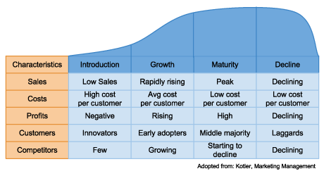

Slide 14
Pricing Strategies
Penetration
Skimming
Prestige
EDLP
Discounts
Bundle
Psychographic
Geographic
Cost Plus

Slide 15
Setting a Price
VERY IMPORTANT!
The six steps for determining price are:
Determine pricing objectives
Study (and list) costs
Estimate demand
Study (and list)competition
Decide on a pricing strategy (provide justification)
Set price

Slide 16
Pricing Strategies
Skimming Pricing – Price is set high to capitalize on the high demand during its introductory period, then later lowered as competition catches up and growth starts to flatten.
What product uses a skimming strategy?

Slide 17
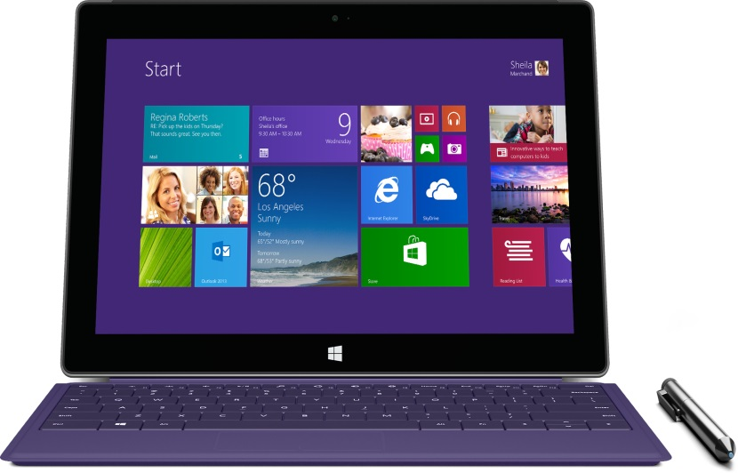
New Technology
Charge high prices initially because people want to be the first to have the latest technology.
They lower the price to attract more customers when sales start to decline.

Slide 18
Pricing Strategies
Penetration Pricing – Initial price is set low in order to “penetrate” a tough market that is saturated by a lot of competitors with similar products. It can also be used to simply encourage as many people as possible to buy a product.
What product uses a penetration strategy?

Slide 19
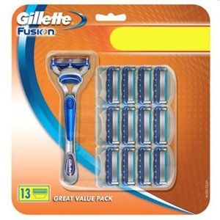
Razors
Set the razor price very low but the replacement razors are very expensive.
Cable, Mobile/Satellite Radio
Offer a low price for an intro period (usually 3-6 months) then raises the rate significantly.

Slide 20
Pricing Strategies
Prestige Pricing – Prices are always set higher than average to suggest status and an upscale image to the consumer.
What product uses a prestige strategy?

Slide 21
Jaguar
Rolex
Gucci
Versace

Slide 22
Pricing Strategies
EDLP – Consistently low prices are set with no intention of ever offering a discount. This pricing strategy is employed when low unit profit margins are expected to be offset by a high sales demand.
What store uses an EDLP strategy?

Slide 23
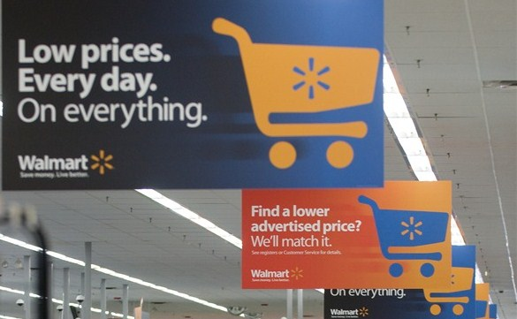
Trader Joes
Wal-Mart
Winn-Dixie
Some item in Macy’s never go on sale because they are EDLP items.

Slide 24
Pricing Strategies
Cost -Plus Pricing – Break-even price is determined then the desired profit is added to arrive at a price. This is used when a bottom line profit margin must be met and the product is predicted to be able to remain in high demand without offering a discount.
What store uses a cost-plus strategy?

Slide 25
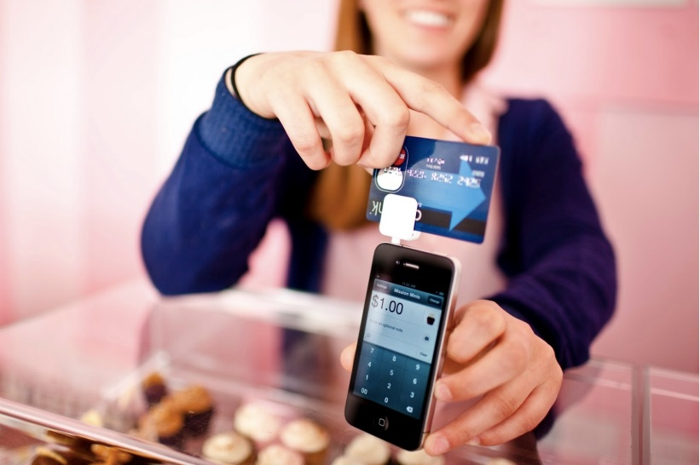
Note: This strategy ignores what the customer thinks the product is worth. You may be losing out on potential income.
CostCo
Credit Card Readers (RevTrak, Square)

Slide 26
Pricing Strategies
Geographical Pricing - Price adjustments required because of the location of he customer and the associated shipping costs.
This is why things are more expensive in Alaska and Hawaii

Slide 27
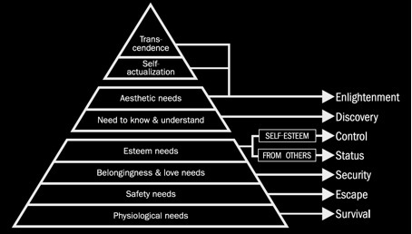
Psychographic
Segmenting a market (and pricing products) by applying lifestyle and mindset descriptions to different type of people.
Click the link below and fins what group you would be placed in on a company’s psychographic grid
LINK

Slide 28
Pricing Strategies

Slide 29
Discount Pricing
Discounts
Seasonal Discounts – Discounts are offered to buyers who are willing to buy in advance of the customary buying season. This prevents cash flow problems by keeping a steady stream of revenue coming into a company all year.
Cash Discounts – Buyers who are willing to pay in cash receive a cheaper price.

Slide 30
Which Strategy to choose?
Every circumstance is different and the strategy usually fluctuates throughout the life cycle.
Question: How can you get a product back into the growth stage once it reaches the maturity stage?

Slide 31
Improve the product
Improve the product packaging
Change the size of the product
Find a new use for the product
Bundle the product
Discount the product

Slide 32
Setting a Price
Remember these?
The six steps for determining price are:
Determine pricing objectives
Study (and list) costs
Estimate demand
Study (and list)competition
Decide on a pricing strategy (provide justification)
Set price

Slide 33
Increasing Your Prices
Be able to justify the price increase to your customers or they will seek other alternatives!

Slide 34
Be able to add
How to make something go Viral
Graphic Design/Movie Creation
CRAP principle, Photoshop/Illustrator techniques
Shark Tank Knowledge
Public Relations
What your committee did this semester
…and you will be able to make a thorough 1st semester review project

Slide 35
It’s Your Turn!
Coca – Cola is looking for a new product to jump start their idle sales. Though people their brand very well, they feel they have reached their potential with the Coca Cola soda product.
Your mission: Develop a new product for Coca-Cola that old Coca-Cola drinkers will want to try (because they are brand loyal).

Slide 36
Include:
A picture of the product
(MUST LOOK REALISTIC!)
A name for the product
A tagline for the product
Discuss how you foresee it going through the life cycle. What will occur at each stage?
What will you do to introduce the product?
What will your pricing strategy be?
What will you do when sales start to decline?

