Slide 1
Viral Video Marketing Plan
Notes
Be sure to follow the 6x6 rule
Add graphics to your pages!
Feel free to use the DESIGN IDEAS that are built in to Power Point

Slide 2
Title Slide
Member names and YouTube link of your video

Slide 3
SITUATIONAL ANALYSIS
PART ONE: SWOT Analysis
INTERNAL | Strengths | Weaknesses
EXTERNAL | Opportunities | Threats
What strengths and weaknesses does your group have.
Which of these would affect the success of your video if you really wanted this to go viral?
Where is there an opportunity for your video to succeed?
What would keep your video from going viral?

Slide 4
SITUATIONAL ANALYSIS
PART TWO: Environmental Scan
Political | Economic
Society/Trends | Technology
Is there anything in the world of politics, the economy, social cultural trends, or technology that can help or hurt the success of my marketing plan?

Slide 5
S.M.A.R.T. OBJECTIVES
Specific, Measurable, Attainable, Results Oriented, Timely
Consists of 2 types of objectives
Financial (How much will you spend and make by a certain date?)
Marketing (Give a specific timeline for specific marketing events)
“Are you going to spend money to advertise? What do you want to see as a result of this video? A certain number of likes, tweets, forwards, etc.? Be sure to include a date.

Slide 6
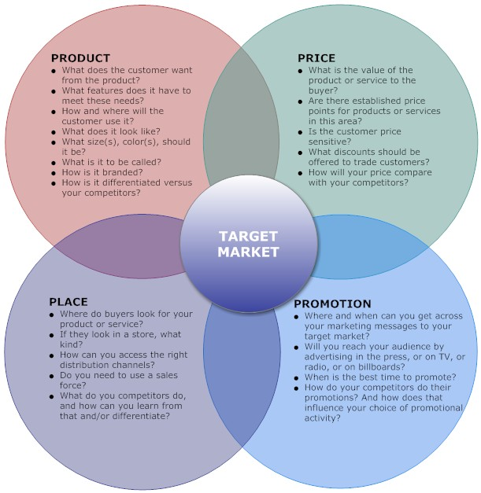

Slide 7
Marketing Mix (4P’s) PRODUCT
Product (Features, Benefits, USP)
What is unique and “great” about your video?
How will it travel through the product life cycle?
SHOW THE LIFE CYCLE!

Slide 8
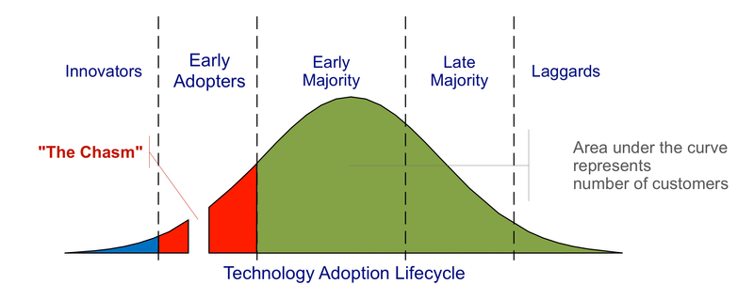
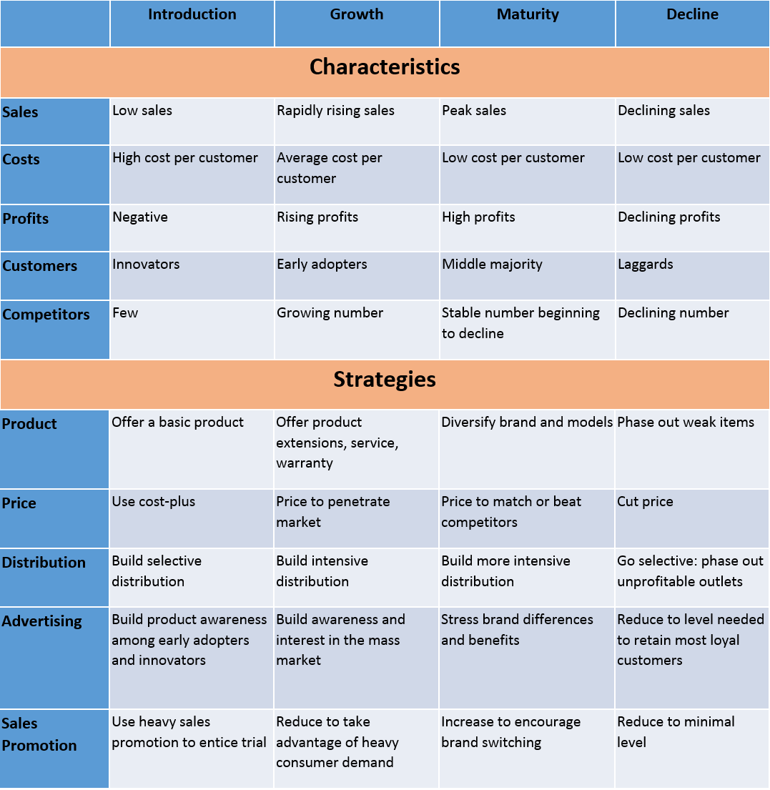

Slide 9
Marketing Mix (4P’s) Place
Where will you place your video? How will it get distributed?

Slide 10
PROMOTION
This is the largest part of your presentation
How will you use STEPPS (Berger), YouTube advice (Alloca), and Karen Cheng to promote?
List 2 other ways that you can advertise your video so that it gets 1 million views.
DON’T FORGET TO PUT A PIC OF YOUR SMART PHONE PROMOTION THAT YOU MADE IN CLASS

Slide 11
Implementation
WHO will do WHAT by WHEN?
Assign roles, dates, responsibilities to your group so that your plan gets done!

Slide 12
Evaluation and Control
What are your performance standards?
How can you measure the effectiveness of your plan?
These are called metrics and are quantifiable (has numbers)
# of visitors to your site, bounce rate, response rate, inbound links, organic visitors, conversion rate (if applicable) etc.
Use the phrase repurposed content, word of mouth advertising, Google Alert, and Google Analytics on your slides!!!!!
Control - If your plan doesn’t work, how will you control your losses (can you do anything to promote the video if it doesn’t get many views in the first 2 weeks? )

