Slide 1
Art of the Kickstart
PodcAst Take-aways

Slide 2
Podcast 1: Ministry of Supply
Owners Took apart sports shirts and socks and turned them into dress shirts and dress socks so they were more comfortable.
“We have grown up with performance clothing so why not use them for dress clothes.”
The owners were all athletes growing up and wanting something that fit like their performance clothing.
They are the intersection of “performance and professional.”

Slide 3
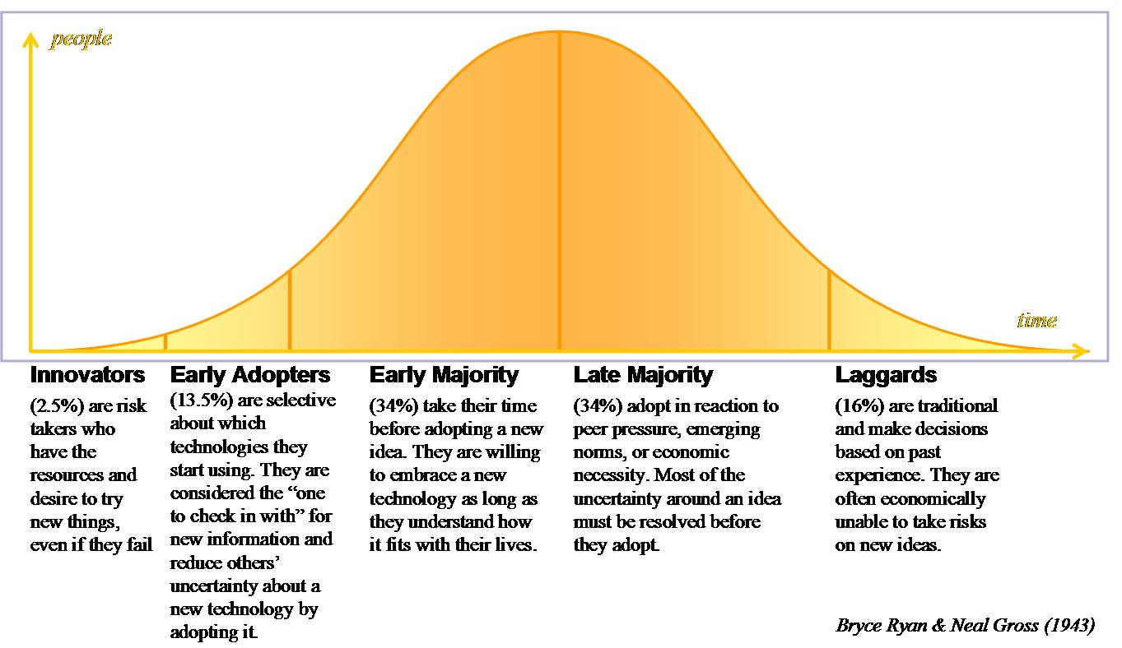
In terms of fulfillment of an order, THEY had to figure Out how to scale their business so they had to rethink their supply chain.
Also used kick starter to test their product with customers to learn about problems.
Kickstarter customers also give feedback on future products!
Early adopters wanted to be involved in future product development testing and feedback .
They used a Human-centered
design process.
¾ backers are repeat backers!

Slide 4
Think through your story lines.
They have built 3 story lines based on different benefits.
they play the appropriate commercial for the target market that is looking/listening through certain media outlets.
MKt Nugget: You can direct viewers to different landing pages based on where the inbound link is coming from!

Slide 5
Benefits of Kickstarter?
You can avert your cash conversion cycle by getting money in advance of making the final version of the product.
DEFINITION: The cash conversion cycle attempts to measure the amount of time each net input dollar is tied up in the production and sales process before it is converted into cash through sales to customers. This metric looks at the amount of time needed to sell inventory, the amount of time needed to collect receivables, and the length of time the company is afforded to pay its bills without incurring penalties

Slide 6
You can plan inventory and demand before launching a product to avoid obscelesence.
Product obsolescence refers to the time and state in which a piece of technology or product ceases to be useful, productive or compatible.
You can preempt questions you have by asking them in the kickstart stage.

Slide 7
The future of crowdsourcing
It will become a participatory way of building products. Crowds will have input in all product launches.
If they can’t they may not back the product. Think about that for SECOND!

Slide 8
Ravean HeATed JAcket

Slide 9
Why Kickstarter?
There are no limits with kickstarting because you can make something and immediately get feedback from the public and repeat the process several times over while receiving feedback about future products as well.
The more you push the boundAries the more successful you will be.
You don’t have to play by conventional rules now.
Don’t have to Pay to play, show sales, etc.

Slide 10
Don’t need to have to have a lot of followers online to have a kickstarter campaign.
Create a 3 page, LINEAR Website
Page 1 is a long sales page. You can only go to page 2 FROM THERE
Page 2 has more details and a buy button.
If they hit buy, Page 3 says “Sorry I’m out of stock.
Places Facebook pixels on that page to tell him what customers are visiting his site through a clickable ad.
Drives ppc to this website and tries to create positive ROI BY getting folks to go through all 3 web pages.
he doesn’t even have a product but can see that people are trying to buy it so he knows the concept is a winner. BRILLIANT!

Slide 11
He convinces vc’s that there is a demand without having to show actual sales.
Anybody can do this for a couple hundred bucks!

Slide 12
Since kickstarter has been around a bit, kickstarter pages should look legitimate.
Folks know about past failures on kickstarters so they can be apprehensive.
He uses kickstarter as a 2nd level market validation.
He doesn’t use it to validate a product (he uses the website for that).
Kickstarter allows him to figure out sku’s, colors, audiences, etc. so when he goes to retail, he knows the products and colors to manufacture.

Slide 13
#1 nugget for online advertising is this: whatever marketing you use, make sure that it goes to people who already know what kickstarter and crowdfunding is.
He tried advertising to people who shop at cabellas, dick sporting goods, etc.
He decided to change his Facebook interest ad words to “kickstarter, crowdstarter, and indiegogo” and he started making a lot money.
You can see on KICKTRAQ (an analytics and discovery forum) that on that day their sales skyrocketed.
Narrowed those results down to geographic factors and his sales grew to 10x what he was making!!!!!!

Slide 14
Without this, they had a 40% clickthrough rate but had a 90% drop off rate (no conversion) in the beginning because people didn’t trust in crowdsourcing. Once they changed the ad interest words, this no longer became a problem.
Cost of acquisition goes way down when you are selling to somebody who has already bought your product or a similar product so if you target someone who doesn’t mind kickstarter products, it doesn’t take a lot of convincing (or money) to get them onboard.
Some won’t buy things that don’t come to them immediately like on Amazon. They feel weird and their trust level goes down. This bypasses those folks in the beginning.

Slide 15
The quicker you can make an email list of current backers of your product and make a look alike list, the more money you will make. This is his #1 technique for success. T
hey Gather audiences of a lot of different products then use the one that most closely matches their newest [product to produce the largest ROI of anything else they do!

Slide 16
Their strategy right now is to keep Ravean very VERTICAL online. Meaning all products have to do with jackets. They don’t have a lot of new products just product extensions.
Horizontally – they want to license out the technology to a lot of other product lines.

Slide 17
China is trying to cut out the middle man as much as possible and go direct to customer.
They really want to do business in the US nowadays
Go find a new factory that is struggling and ask them to make products for you that are being sold In America.
He tweaked a technology that was being used by a factory in China and meshed it with his own to create a down jacket.
He gave the Chinese owner a 10% equity in the new product so he had skin in the game.
That owner totally financed the launch and production of the new product because they needed the revenue so badly.
Find a factory with the base technology and integrate your own to create something great.
Chinese don’t have skills and experience to sell in the US so they need you.
As an American, you can set up a bank account and amazon account. It takes a lot to do this if you live in China. This is an example of taking a risk and creating your own rules.

Slide 18
What did his TEACH A MAN TO FISH quote mean?
What is FBA Allstars
Description
“This is FBA Allstars, ground zero for building bigger, better, private label profits and expanding existing Amazon businesses. I’m aiming for a 7 figure exit from my Amazon brand at the end of year one - aim high, accomplish the incredible. That is the purpose behind FBA ALLSTARS, pushing to accomplish your goals. This group is mastermind of FBA success. Feel free to share your goals, team up or do what it takes to push you towards your Amazon end game. Sharing strategies and screenshots, resources and results help the entire private label community and add some much needed accountability our own Amazon seller stories. So, are you willing to take the FBA ALLSTARS challenge? Are you willing to bust your butt to make it happen? If so, let's get started! “

Slide 19
Roy Morejon of Command Partners – Revean earbuds
PodCAst notes

Slide 20
Take risk but take calculated risks. They saw mobile wearables and overall headphones sales on the rise but nothing that had a custom fit option.
Do a needs assessment
SWOT ANALYSIS is a form of needs assessment.
Look at what is needed and rank the list by importance and feasability
https://www.slideshare.net/MMCErinLett/2014-08216stepstoaneffectiveneedsassessmentforcorporatetraining

Slide 21
They went to HAX and was able to create a partnership with Onkio. When it comes to electronics, you need to line up manufacturing from china and know the costs.
Don’t do this AFTER your campaign because it will be tough to deliver. All Chinese factories say they have technology to create your product but they don’t have capabilities.
You need to go see their factory first hand or the first samples will not look good!
Timescales are different in China. You can get things much quicker for much less if it comes from China.

Slide 22
Stayed with HAX for 11 weeks. HAX is a venture capital-based program dedicated to accelerating startups with a hardware element (they are the world largest hardware accelerators).
They give founders the resources necessary to move with lightning speed.
They operate accelerators in the areas of hardware, software, biology, food, robotics, medical devices, transportation, green energy and more.

Slide 23
Need a good video (get a good video guy) , need good pr (get a good pr guy). The kickstart web page set up process takes 2 months if you hire outside professionals.
Advice: Have a diversified team with different backgrounds.
Let backer snow that you have the ability to deliver any amount of product at any time so that trust is set.
Some backers have gone bankrupt or not been able to keep up with demand so backers are a bit weary now.
Show them your implementation plan. Backers are more cautious now.
Showing they have paid their dues and visited China makes backers feel good.

Slide 24
How to boost a business post
https://undullify.com/boosting-posts-on-facebook-all-your-burning-questions-answered/
https://www.youtube.com/watch?v=6itT-QZ_EMM

