Slide 1
7 functions of Marketing

Slide 2
The 7 functions of Marketing!
Selling
Distribution
Product Service Management
Marketing Information Management
Promotion
Pricing
Financing

Slide 3
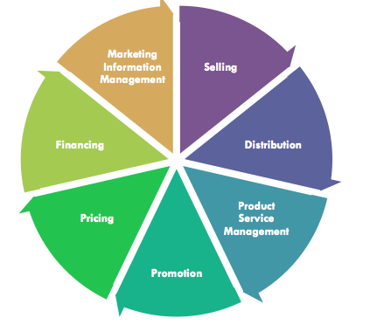
The Core of Marketing
The 7 Functions of marketing are the basis for all marketing activities
All marketing activities involve at least one of the functions

Slide 4
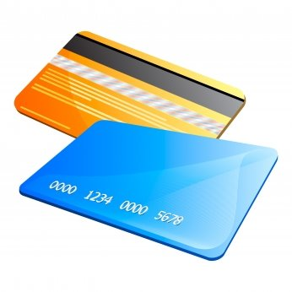
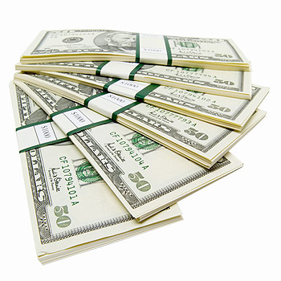
Financing
Requires a company to budget for its own marketing activities
Assisting customers in paying for the company’s products

Slide 5
Financing
Customer Financing
Customers may receive financing in the form of different payment options, such as cash, credit, and installment payment
More options = More purchases

Slide 6
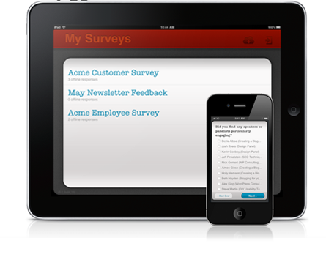
Marketing Information Management
Surveys
Process of collecting information about customer trends, and competitor products
Used to determine customer demographics, buying habits, and attitudes

Slide 7
Marketing Information Management
Sporting Industry
Successful marketing involves using marketing info to predict consumer demand and estimate the right quantities of merchandise

Slide 8
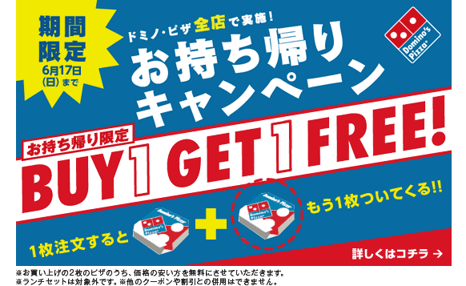
Marketing Information Management
When Domino’s first considered expanding operations into Japan, it used its marketing research finding to adapt its traditional pizza to Japanese tastes
Notes:
They offered nontraditional topping on the pizza in Japan such as corn and tuna because of local preferences.

Slide 9
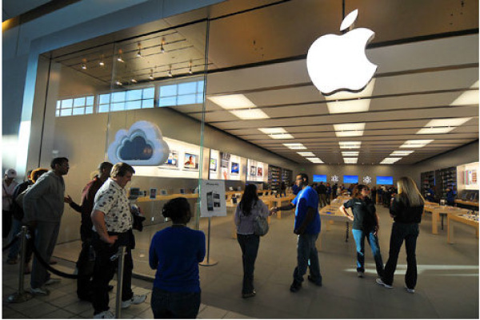
Pricing
The process of establishing and communicating to customers the value of cost of goods and services
Prices assigned to sports and entertainment events and goods are directly related to consumer demand
Release of iPhone 6

Slide 10
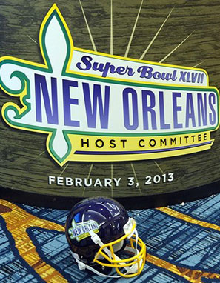
Pricing
Super Bowl ticket prices go through the ceiling since there are limited number of tickets and enormous demand

Slide 11
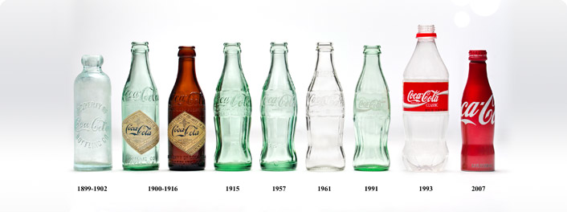
Product/Service Management
*See how the Coca-Cola bottles have changed with the times and with customer’s needs and wants! ☺
Obtaining, developing, maintaining, and improving a product or product line to respond to customer needs and wants

Slide 12
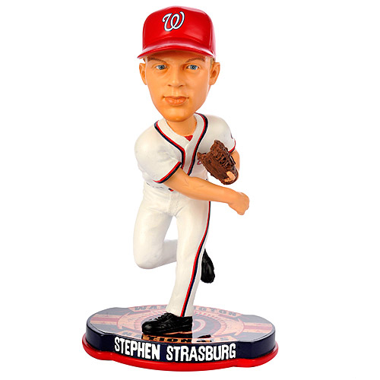
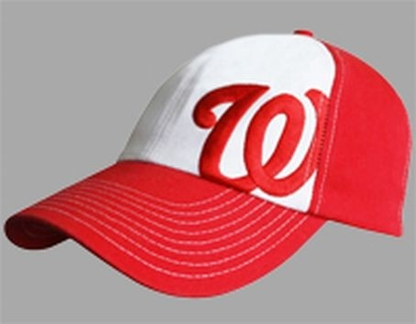
Promotion
Any form of communication used to inform, persuade, or remind people about a business’s products
Nationals
Free baseball hats, bobble heads, t-shirts, etc are given away at a baseball game

Slide 13
Selling
Any direct and personal communication with customers to asses and satisfy their needs and wants is considered selling
Selling involves not only satisfying customers but also anticipating their future needs
EX: A sales person answers questions about the operation of a running watch

Slide 14
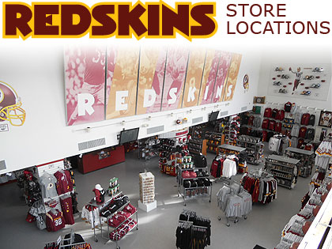
Distribution
Making decisions about where to sell the product and how it gets there
Example:
Redskins Apparel
Redskins Store (Dulles and Fair Oaks Mall)
Department Stores
JCPenney, Kohls
Online Website

